Slide 1

CAPSTONE PROJECT CREDIT CARD DEFAULT PREDICTION
PREPARED BY
SAAQUIB MUSTAFA
SAHIL KOLAMBKAR
RAJA CHOWDHURY
SANDIPAN DAS
RAHUL MUKHERJEE

Slide 2
INDEX
INTRODUCTION
PROBLEM STATEMENT
DATA SUMMARY
APPROACH OVERVIEW
BASIC EXPLORATION
EDAs
MODELING OVERVIEW
FEATURE IMPORTANCES
CHALLENGES
CONCLUSION

Slide 3

INTRODUCTION
Credit card default prediction is the process of using historical data to predict whether or not a credit card holder will default on their payments in the future. Default prediction is important for both lenders and borrowers, as it can help lenders to identify high-risk customers and make better lending decisions, while helping borrowers to understand their chances of default and take steps to avoid it.

Slide 4

PROBLEM STATEMENT
Predicting whether a customer will default on his/her credit card.

Slide 5

Data Summary
X1 -Amount of credit limit(includes individual as well as family credit)
X2 -Gender
X3 -Education
X4 -Marital Status
X5 -Age
X6 to X11 -History of past payments from April to September
X12 to X17 -Amount of bill statement from April to September
X18 to X23 -Amount of previous payment from April to September
Y -Default payment

Slide 6

APPROACH OVERVIEW
Data Cleaning and Understanding
Find information on documented columns values
Clean data to get it ready for Analysis
Data Exploration (EDA)
Examining the data with visualization
Plotting graphs
Modeling (Machine Learning) METRICS
Logistic Regression 1. Confusion Matrix
Support Vector Classifier 2. Accuracy Score
Decision Tree Classifier 3. Precision Score
Random Forest Classifier 4. Recall Score
XGBoost 5. F1 Score 6. Roc_Auc Score

Slide 7

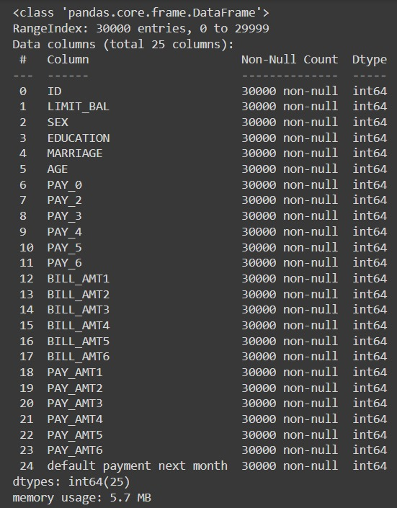
BASIC EXPLORATION
Dataset for Taiwan.
Shape of data is 30000 rows and 25 columns
Six months payment and bill data available.
No null data.
Nine Categorical variables present.
ID column can be drop

Slide 8

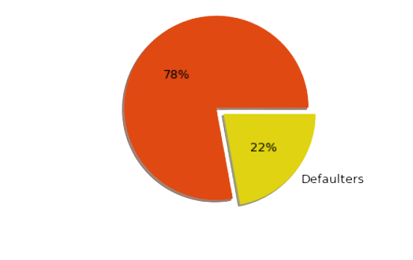
Ratio of Defaulter to Non-Defaulter
In our dataset the ratio of defaulter to non defaulter is 78:22
That is 22% are defaulters while the rest pays on time.

Slide 9

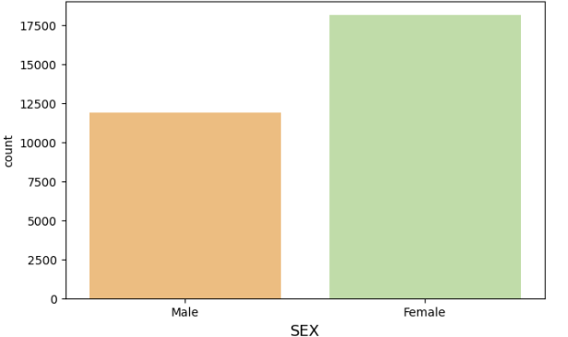
GENDER DISTRIBUTION
In our dataset,
There are 11,888 Males or 39% and
18,112 Females or 61%.

Slide 10
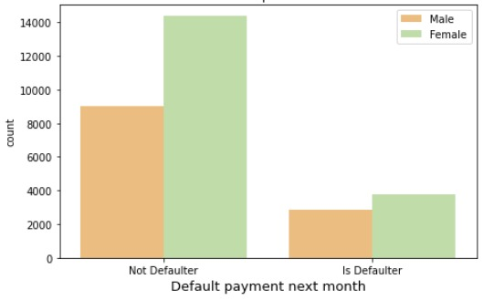
DEFAULTER RATIO WITH RESPECT TO GENDER
The Defaulter ratio with respect to gender
is 43% of Males are defaulter
while 57% of Females are defaulter.

Slide 11
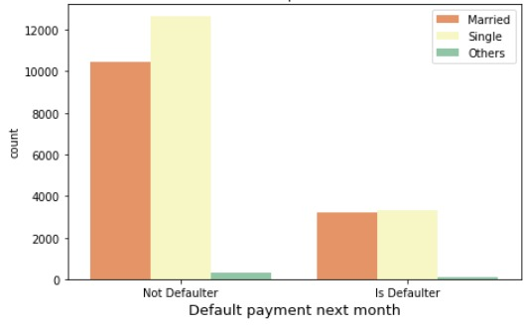
DEFAULTER RATIO WITH RESPECT TO MARITAL STATUS
The defaulter ratio according to marital status are as follows:
Married : 50%
Unmarried : 49%
Single : 1%
The above calculation says that
Married people are more likely to
fail to pay on time while Single people
often pays on time.

Slide 12
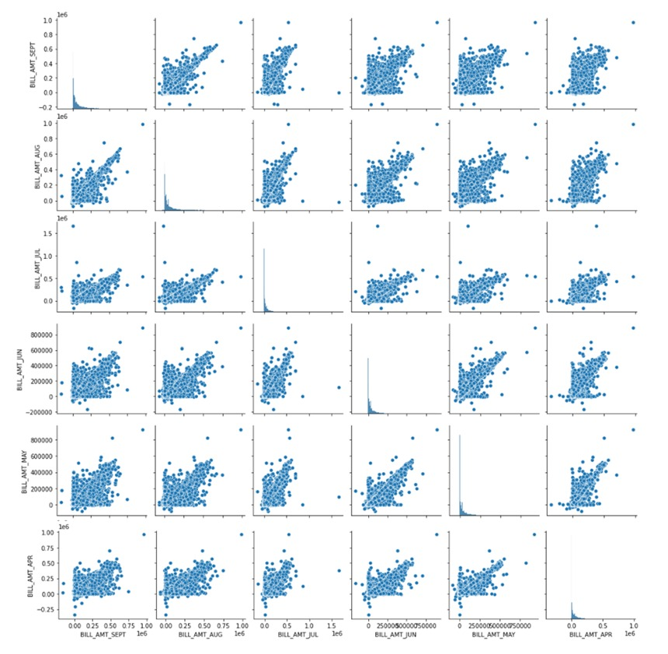
HISTORY OF
BILL AMOUNT PAYMENT

Slide 13
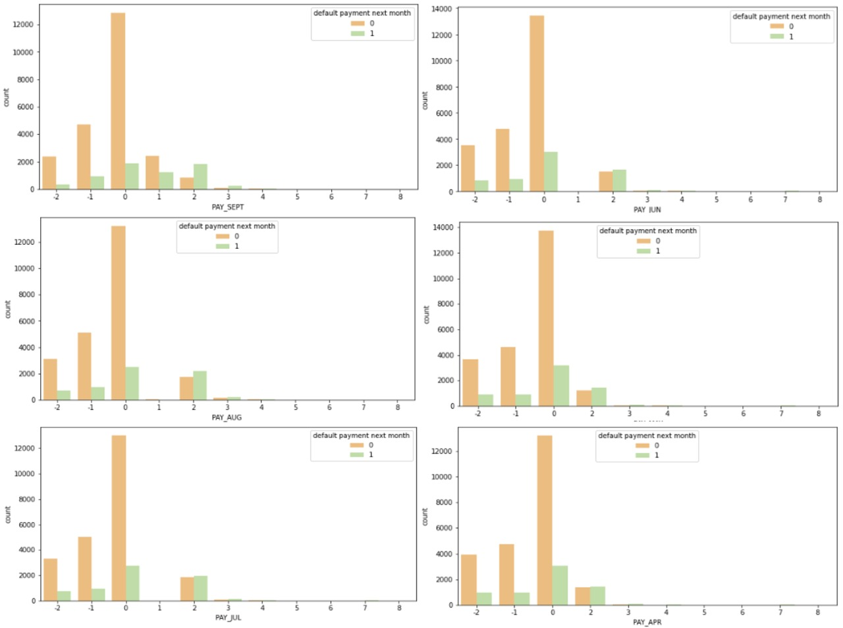
HISTORY OF PAY AMOUNT PAYMENT

Slide 14
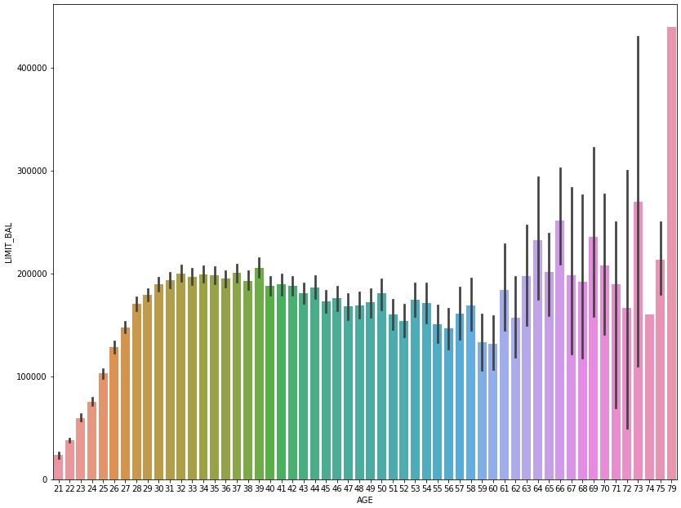
ALLOTMENT OF CREDIT LIMIT BALANCE
Trend of limit balance is mixed
from age 21 to 39, it is
increasing after it has declined
a bit but from 62 it is increasing
the limit has increased
drastically.
Highest balance given to the
age of 79.

Slide 15

MODELING OVERVIEW
Supervised learning/Binary Classification
Imbalance data with 78% non-defaulters and 22% defaulters
Modeling (Machine Learning) METRICS
Logistic Regression 1. Confusion Matrix
Support Vector Classifier 2. Accuracy Score
Decision Tree Classifier 3. Precision Score
Random Forest Classifier 4. Recall Score
XGBoost 5. F1 Score 6. Roc_Auc Score

Slide 16
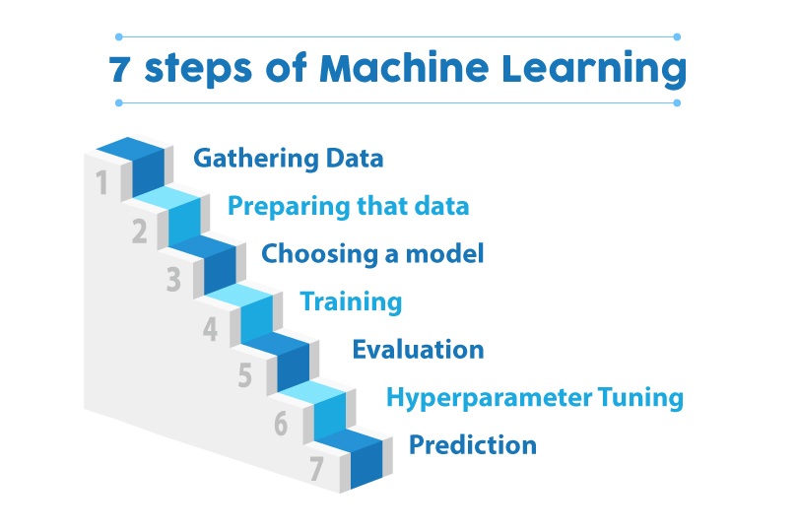
MODELLING STEPS
Data Preprocessing
Feature selection Feature engineering
Train test data split(80%-20%)
SMOTE oversampling(Synthetic Minority Oversampling Technique)
Data Fitting and Tuning
Start with default model parameters
Hyperparameter tuning
Measure AUC- ROC on training data
Model Evaluation
Model testing
Precision Recall Score
Compare with the other models

Slide 17
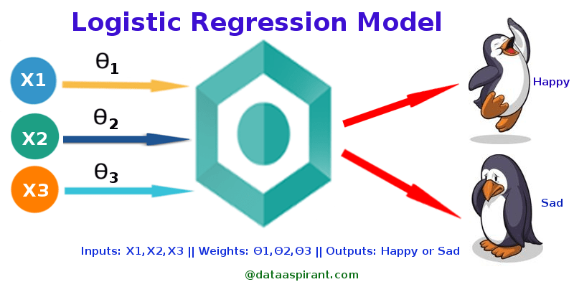
LOGISTIC MODELLING
PARAMETERS: C = 0.0, Max_iter = 50, Penalty = none
RESULTS:
The accuracy on test data : 56%
The precision on test data : 36%
The recall on test data : 60%
The f1 score on test data : 56%
The roc_auc on test data : 57%

Slide 18
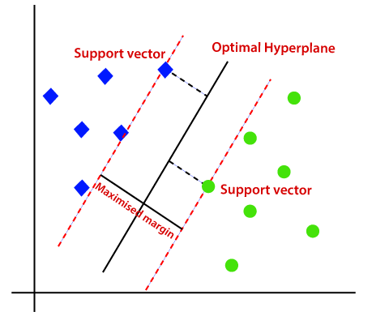
SUPPORT VECTOR CLASSIFICATION
PARAMETERS: C = 0.5
RESULTS:
The precision on test data : 60%
The recall on test data : 69%
The accuracy on test data : 61%
The f1 score on test data : 64%
The roc_auc on test data : 51%

Slide 19
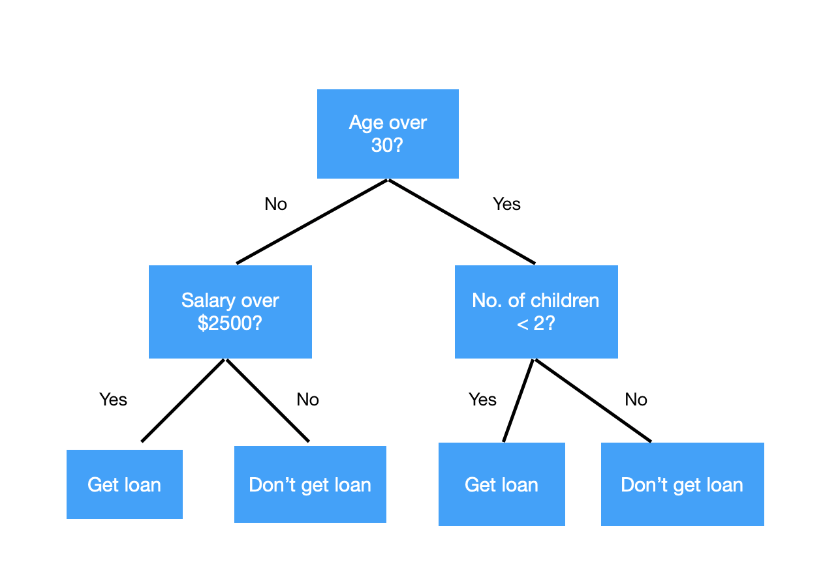
DECISION TREE CLASSIFIER
PARAMETERS: min_sample_leaf = 8, min_sample_split = 2
RESULTS:
The precision on test data : 60%
The recall on test data : 69%
The accuracy on test data : 61%
The f1 score on test data : 64%
The roc_auc on test data : 51%

Slide 20
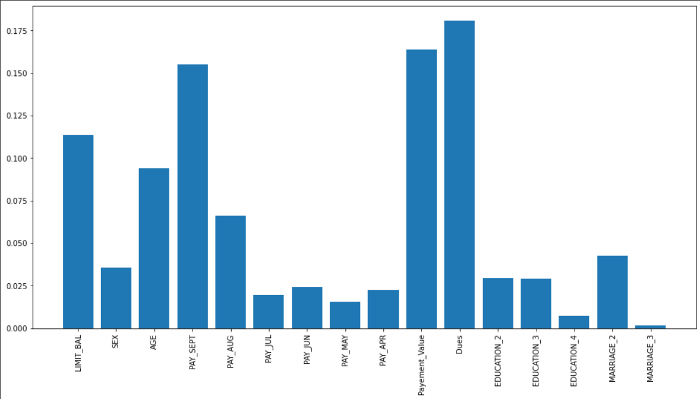
DECISION TREE FEATURE IMPORTANCES

Slide 21
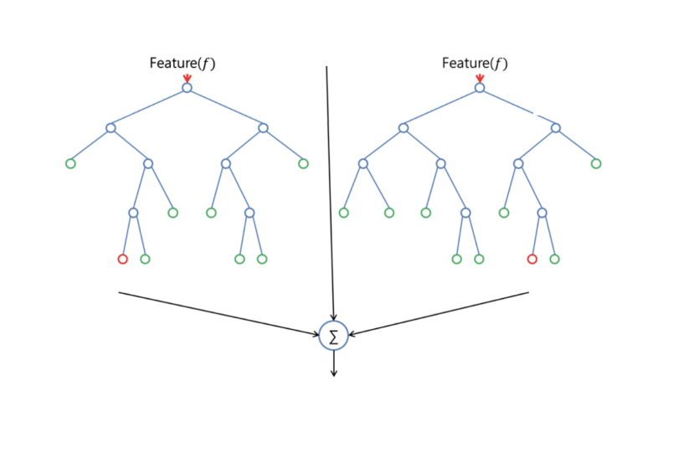
RANDOM FOREST CLASSIFIER
PARAMETERS: min_sample_leaf = 1, min_sample_split = 2
RESULTS:
The precision on test data : 86%
The recall on test data : 82%
The accuracy on test data : 84%
The f1 score on test data : 84%
The roc_auc on test data : 84%

Slide 22
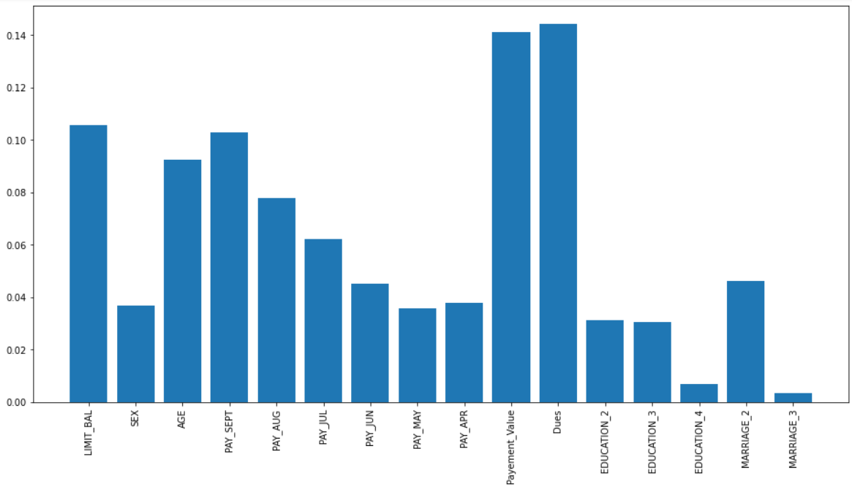
RANDOM FOREST FEATURE IMPORTANCES

Slide 23
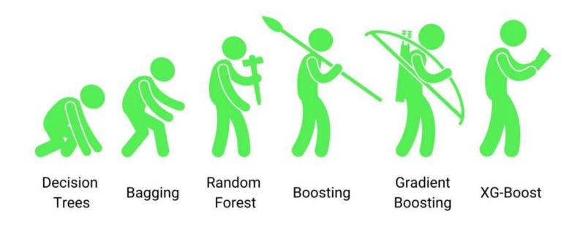
XGBOOST
PARAMETERS: learning_rate = 0.30000000000000004
RESULTS:
The precision on test data : 84%
The recall on test data : 77%
The accuracy on test data : 81%
The f1 score on test data : 80%
The roc_auc on test data : 81%

Slide 24
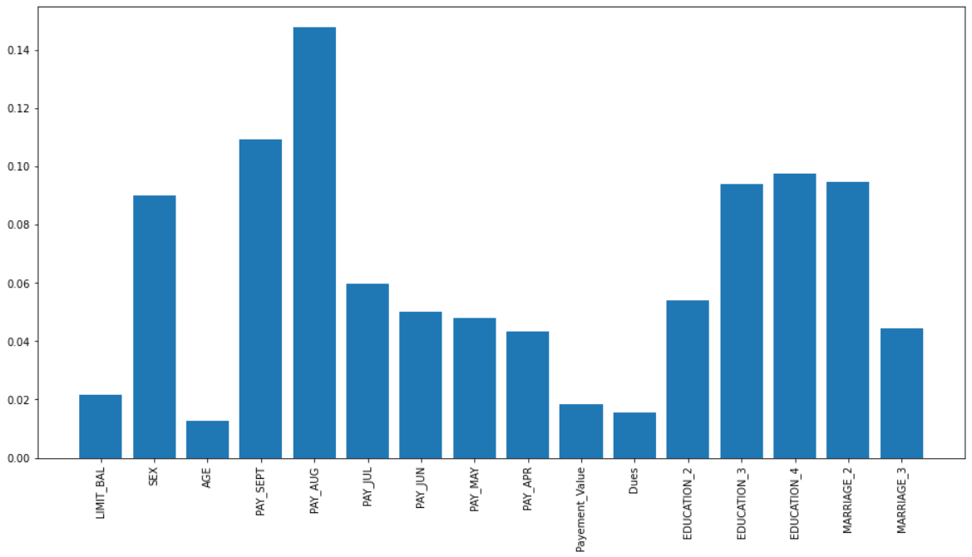
XGBOOST FEATURE IMPORTANCES

Slide 25

CHALLENGES
9 Categorical variables present.
Huge dataset.
Understanding the columns.
Feature engineering.
Getting a higher accuracy on the models.

Slide 26
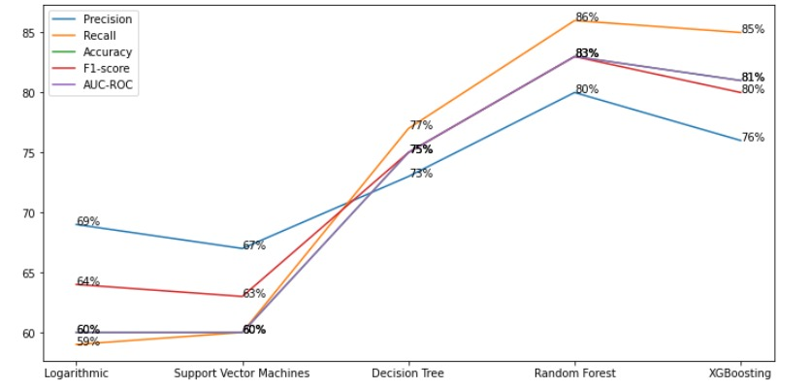
PERFORMANCE OF DIFFERENT METRICS

Slide 27
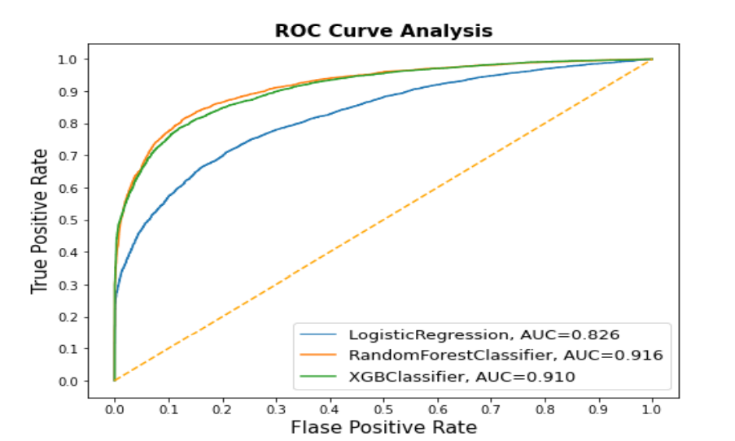
AUC_ROC CURVE COMPARISION

Slide 28

CONCLUSION
Random forest is the best algorithm for our model. Recall is 86%(meaning out of 100 defaulters 86 will be correctly caught by Random forest)
Support Vector Machines has the least recall score of 60%
SR.NO | CLASSFIER | ACCURACY | PRECISION | RECALL | F1 SCORE | ROC_AUC
01 | LOGISTIC REGRESSION | 56% | 36% | 60% | 56% | 57%
02 | SVC | 61% | 60% | 69% | 64% | 51%
03 | DECISION TREE | 61% | 60% | 69% | 64% | 51%
04 | RANDOM FOREST | 84% | 86% | 82% | 84% | 84%
05 | XGBOOST | 81% | 84% | 77% | 80% | 81%

Slide 29

THANK YOU

